Slide 1
Data Mining: First View
CSE4416 – Introduction to Data Mining
Classroom code: mc0lxd

Slide 2

Outline
What is Data Mining?
Why Data Mining? Why Is It Important?
History of Data Mining
Architecture: Typical Data Mining System
Data Mining Applications

Slide 3


What is Data Mining?
What is Data Mining?
Data mining is the non-trivial extraction of valid, previously unknown, and
potentially useful knowledge from large databases. [Cios et al., 1998]
Extraction of knowledge from data
Data
Data Mining
Knowledge
D2K

Slide 4
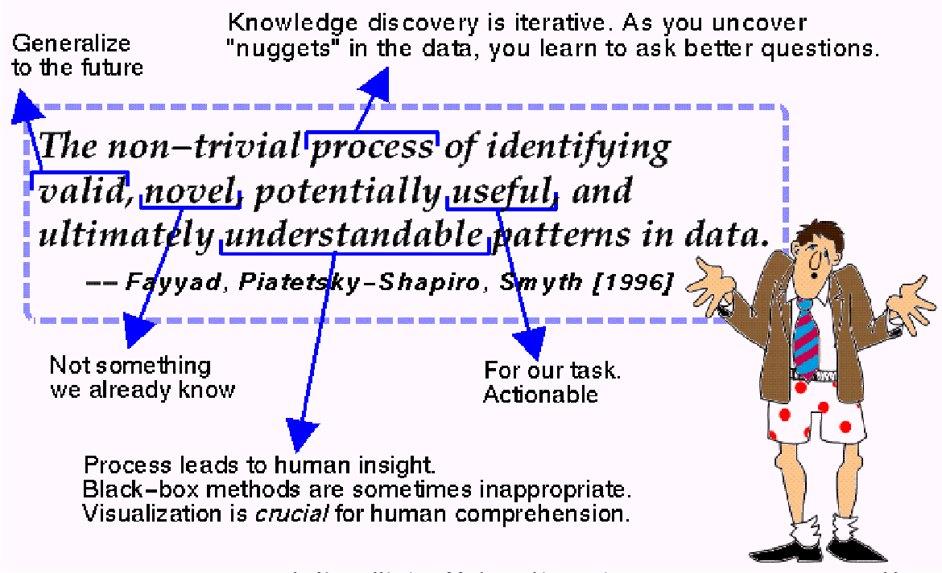
What is Data Mining?

Slide 5
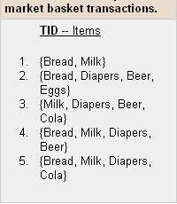
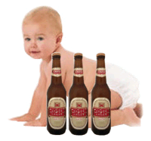
Data Mining Example
Data
Market sales in ten years
Knowledge
Many customers (%75) who buy diapers also buy beer on every Friday.
Moved the beer and snacks Increased sales on peanuts
such as peanuts next to the diapers by more that 27%

Slide 6
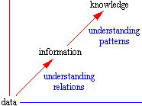
Data – Information – Knowledge
Data
  Facts, numbers, statement of event without relation to other things
  Exp: It is raining.
Information
  Data that are processed to be useful; provides answers to "who", "what", "where", and "when" questions
  The understanding of a relationship, possibly cause and effect.
  Exp: The temperature dropped 15 degrees and then it started raining.
Knowledge
  Application of data and information; answers "how" questions
  What is described or What will happen next
  Exp: If the humidity is very high and the temperature drops substantially the atmospheres is often unlikely to be able to hold the moisture so it rains.
Knowledge
Information + rules
Information
Data + context
Data

Slide 7
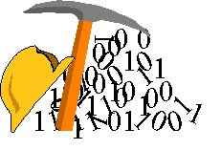
What is not data mining?
What is not data mining?
  (Deductive) query processing.
  Presenting data in different ways
Examples:
What is not Data Mining?
  Look up phone number in phone directory
  Search on documents for information
What is Data Mining?
  Classification of persons in phone directory according to their properties
  Cluster similar documents according to their context

Slide 8
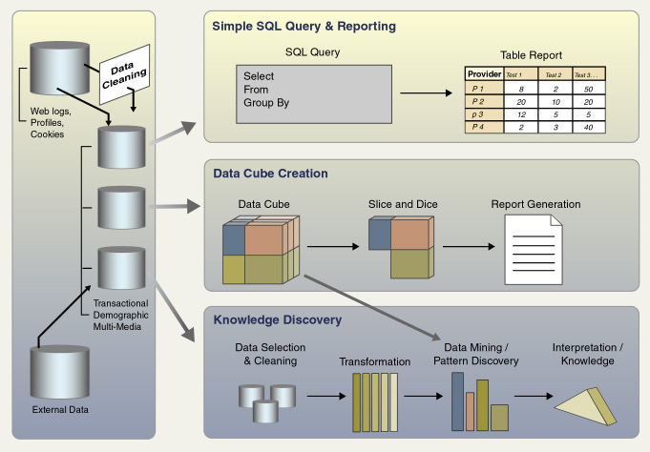
DBMS, OLAP, and Data Mining
Notes:
Veri ambarı ile sağlanan veri kaynagı temelinde karar vermeye yardımcı olacak şekilde yapılan veri analizi ve sorgulama islemlerine OLAP denir
OLAP analitik islemler için tasarlanmıs, çok boyutlu ve özet bilgilerin tutulduğu veri tabanlarıdır.
Burda Analitik işlemlerden kasıt ise OLTP sistemlerinde tutulan verilerin belli kriterlere göre gruplanması ve saklanması islemidir.

Slide 9
Why Data Mining?
Automatic data capture of transactions
  Bar codes
  Satellites
  Scanners
  Cameras
Huge amount of data
Fast, accurate, and scalable data analysis techniques are needed to extract useful knowledge.
Knowledge discovered from data can be used for competitive advantage
Many interesting things cannot be found using database queries
  Exp: “Find me people likely to buy my products”
  Web sites
  Sensors
  Telescope
  E-commerce
  Bank / Credit Card transactions
  Mobile applications
  Social media
  … etc.

Slide 10

Evaluation of Database Technology
1960s:
Data collection and database creation – primitive file processing
1970s:
Relational data model, relational DBMS implementation
1980s:
Advanced data models (extended-relational, OO, deductive, etc.) Application-oriented DBMS (spatial, scientific, engineering, etc.)
1990s
Data mining and data warehousing, multimedia databases, and web databases
2000s
Stream data management and mining
Data mining and its applications
Web technology (XML, data integration) and global information systems

Slide 11

Sub-Data Mining Areas
Data Mining is the extraction of useful patterns from data sources, e.g., databases, texts, web, image.
According to the data source
  Text Mining
  Web Mining
  Multimedia Data Mining
  Spatial Data Mining
  Data Stream Mining
  ...

Slide 12
Classification of Data Mining Models
Learning
Supervised Learning
Unsupervised Learning
Classification
Clustering
Decision Tree
Association Rule Mining
Naive Bayes
Sequential Pattern Mining
Nearest Neighbour
Outlier Detection
Neural Network
Support Vector Machine
Regression

Slide 13

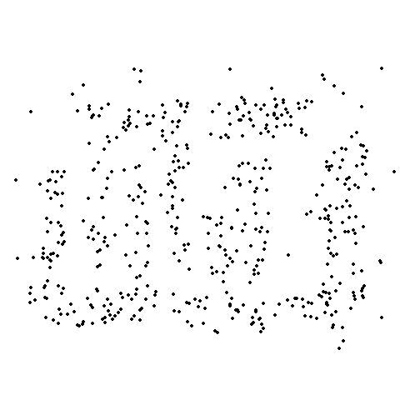
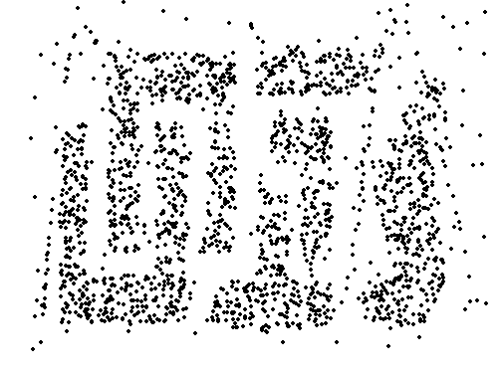
Sample Size
Database must be very large
  Sears: 70 terabytes
  Kmart: 90 terabytes
  Unilever (North America): 106 terabytes
  Wal-Mart: 285 terabytes
  1 terabyte = 1,000 gigabytes = 1,000,000 megabytes = 10¹² bytes

Slide 14
Intersection of Multiple Disciplines
Database Systems
Statistics
Machine Learning / AI
Visualization
Information Science
High Performance Computing
Other disciplines:
  Neural Networks, Mathematical Modeling, Information Retrieval, Natural Language Processing ...
Statistics/
AI
Machine Learning/
Pattern
Recognition
Data Mining
Database systems

Slide 15



Architecture: Typical Data Mining System
Graphical user interface
Pattern evaluation
Data mining engine
Data warehouse
Data Preprocessing
Database
Data
Mart
Web
Pages
…
Files

Slide 16
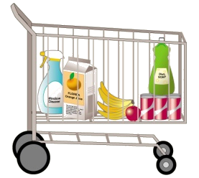
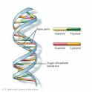




Data Mining Applications
Marketing
Banking, Insurance and Finance
Telecommunication
Health, Drug Industry and Bioinformatics
Outlier and Fraud Detection
Science and Engineering
  Astronomy,
  Industry,
  Chemistry,
  Sports,
  Network
  …

Slide 17

Data Mining Applications
Marketting
  Retail Marketing
  Target Marketing
    Finding clusters of customers who share the same characteristics: interest, income etc.
    Determining customer purchasing patterns over time
  Customer Relationship Management (CRM)
    Finding which of my customers are likely to be the most loyal?
  Market Basket Analysis
    Finding which items are most frequently purchased together.
  Market Segmentation
    Dividing a market into subparts based upon different needs or product preferences.
  Customer Profiling
    What types of customers buy what products (clustering or classification)
  Customer Requirement Analysis
    Identifying customer requirements
    identifying the best products for different customers
  Campaign Analysis
    Identifying potential customers

Slide 18

Market Basket Example
?
Where should detergents be placed in the
Store to maximize their sales?
?
Are window cleaning products purchased
when detergents and orange juice are
bought together?
?
Is soda typically purchased with bananas?
Does the brand of soda make a difference?
?
How are the demographics of the
neighborhood affecting what customers
are buying?

Slide 19

Data Mining Applications
Marketting - A producer wants to know….
Which are our
lowest/highest margin
customers ?
Who are my customers
and what products
are they buying?
What is the most
effective distribution
channel?
What product prom-
-otions have the biggest
impact on revenue?
Which customers
are most likely to go
to the competition ?
What impact will
new products/services
have on revenue
and margins?

Slide 20


Data Mining Applications
Banking, Insurance and Finance
Banking
  Forecast levels of loans
  Fraudulent credit card use
  Predict credit card spending by new customers
  Clustering bank customers
  Risk analyses
  …
Insurance
  Forecast claim amounts
  Forecast risks
  Exp. medical coverage costs, auto insurance
  Predict which customers will buy new insurance policies
Rialto
  Forecast share values

Slide 21
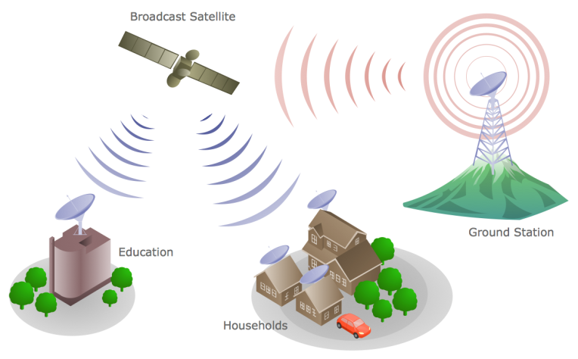
Data Mining Applications
Telecommunication
Analysis of telecommunication data
  Understand the business involved
  Identify telecommunication patterns
  Catch fraudulent activities
  Make better use of resources
  Improve the quality of service
  Intensity of the lines
Multidimensional analysis of telecommunication data
    calling-time,
    duration,
    location of caller,
    location of callee,
    type of call, etc.

Slide 22
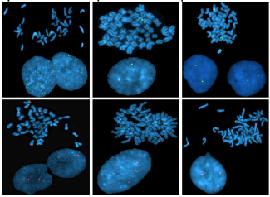
Data Mining Applications
Health, Drug Industry and Bioinformatics
Health care
  Correlate demographics of patients with critical illnesses
  Develop better insight to identify and treat symptoms and their causes.
  Gene maps (30,000 gene)
  Doctor – patient relationship management
  Medical decision support system
  …
Drug Industry
  Drug development
  Relationship between drugs and diseases
  Side effects of drugs
  …

Slide 23
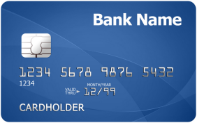
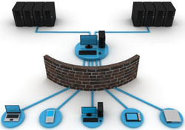

Data Mining Applications
Outlier and Fraud Detection
Detect significant deviations from normal behavior
Applications:
  Credit Card Fraud Detection
  Network Intrusion Detection
  Abnormal customer behaviors

Slide 24
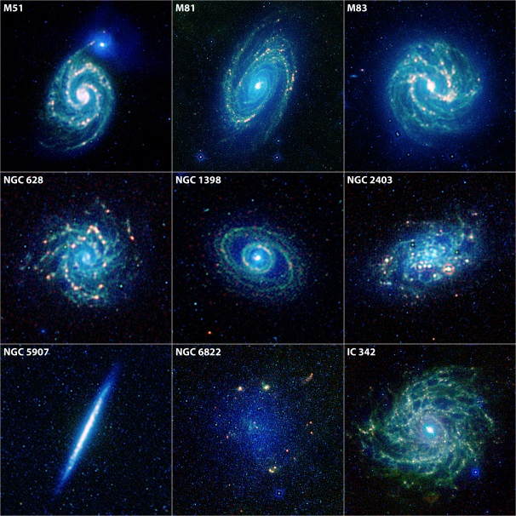

Data Mining Applications
Science and Engineering
Science and Engineering
  Astronomy
    Classification of 20 million galaxies
    Discovery and Classification of new objects
    JPL and the Palomar Observatory discovered
    22 quasars with the help of data mining
  Industry
  Chemistry
  …
Others
  Sports
    NBA game statistics (shots blocked, assists, and fouls) to gain competitive advantage for New York Knicks and Miami Heat
  ...

Slide 25
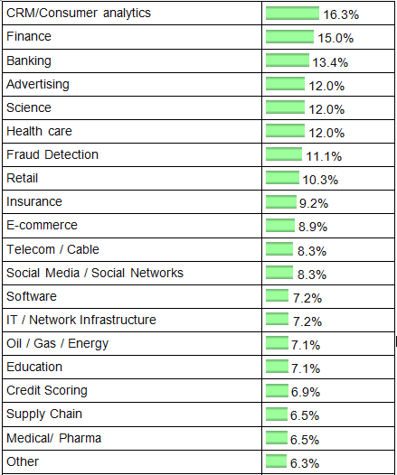
Industries / Fields where applied Data Mining (2016)
http://www.kdnuggets.com/2016/12/poll-analytics-data-mining-data-science-applied-2016.html

Slide 26















Data Mining Case Studies
US Internal Revenue
Global Air Freight Company
Social Security Administration
Ministry of Sound, UK
(for Disney)
Chicago
US Drug
Italian Bank
Casino Group, French
Herlitz AG, Germany
The Banca Marche Group
French
Herlitz AG
GfK Panel Services, Benelux
Babson College
Ililinois Department of Transportation
NOP World, US
Anheuser-Busch
Hewlett-Packard

Slide 27

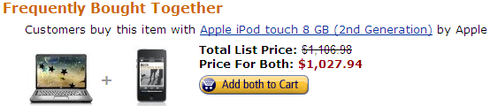
Amazon
HP Pavilion DV5-1140US 15.4-Inch Laptop

Slide 28
Data Mining Software / Tools
Python
R
RapidMiner
Weka
Orange
KNIME
Microsoft SQL Server Analysis Services
IBM SPSS Modeler
SAS Enterprise Miner
SAP (Hana)
Apache Mahout
Oracle Data Miner
IBM Cognos
Tanagra

Slide 29
Final Comments
Data Mining can be utilized in any organization that needs to find patterns or relationships in their data.
Who and Why needs Data Mining?
  …(almost) everybody having the data
  …to get something more out of the data

Slide 30
Slides are acknowledged from:
Assoc. Prof. Dr. Derya BİRANT
TextBook:
Han, J. & Kamber, M., Data Mining: Concepts and Techniques, Elsevier, Third Edition, 2011.
Complementary Book:
1. Roiger, R.J., & Geatz, M.W., Data Mining: A Tutorial-Based Primer, Addison Wesley, USA, 2003.
2. Dunham, M.H., Data Mining: Introductory and Advanced Topics, Prentice Hall, New Jersey, 2003

Slide 31
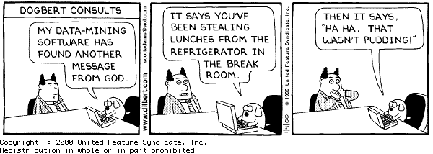

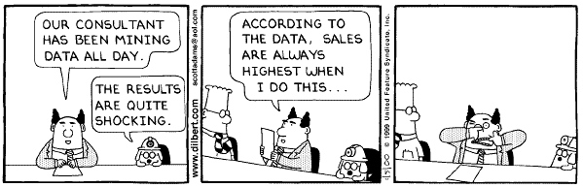
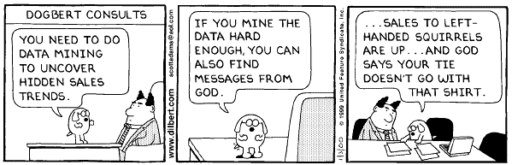
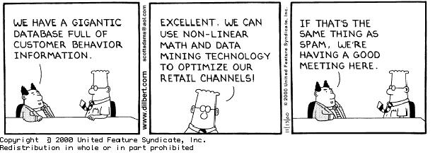
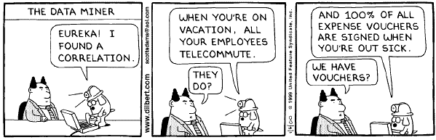
Dilbert - Dogbert

